Slide 1
ICNet for Real-Time Semantic Segmentation on High-Resolution Images
arXiv:1704.08545v2 [cs.CV] 20 Aug 2018

Slide 2
Contents
Introduction
Related Work
Image Cascade Network
Speed Analysis
Network Architecture
Cascade Feature Fusion
Cascade Label Guidance
Experimental Evaluation
Conclusion

Slide 3
1. Introduction
Development of recent deep convolutional neural networks (CNNs) makes remarkable progress on semantic segmentation
CNN-based semantic segmentation mainly exploits fully convolutional networks (FCNs).
It is common wisdom now that increase of result accuracy almost means more operations, especially for pixel-level prediction tasks like semantic segmentation.

Slide 4
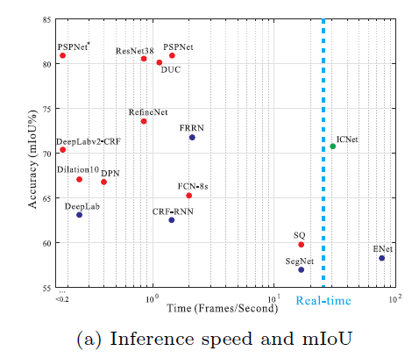
1. Introduction

Slide 5
1. Introduction
Our method is the first in its kind to locate in the top-right area
Image cascade network (ICNet), a high efficiency segmentation system with decent quality
Notes:
Decent : 그럭저럭

Slide 6
1. Introduction
We develop a novel and unique image cascade network for real-time semantic segmentation, it utilizes semantic information in low resolution along with details from high-resolution images efficiently
The developed cascade feature fusion unit together with cascade label guidance can recover and refine segmentation prediction progressively with a low computation cost
Our ICNet achieves 5x speedup of inference time, and reduces memory consumption by 5x times. It can run at high resolution 1024x2048 in speed of 30 fps while accomplishing high-quality results
Notes:
Decent : 그럭저럭

Slide 7
2. Related Work
High Quality Semantic Segmentation
FCN is the pioneer work to replace the last fully-connected layers in classification with convolution layers
Deep Lab used dilated convolution to enlarge the receptive field for dense labeling. Encoder-decoder structures can combine the high-level semantic information from later layers with the spatial information from earlier. Multi-scale feature ensembles are also used.

Slide 8
2. Related Work
High Efficiency Semantic Segmentation
In object detection, speed became one important factor in system design 🡪 Recent Yolo and SSD are representative solutions.
In semantic segmentation, Enet is lightweight networks. These methods greatly raise efficiency with notably sacrificed accuracy.

Slide 9
2. Related Work
Video Semantic Segmentation
FSO performs structured prediction with dense CRF applied on optimized features to get temporal consistent predictions
NetWarp utilizes optical flow of adjacent frames to warp internal features across time space in video sequences.

Slide 10
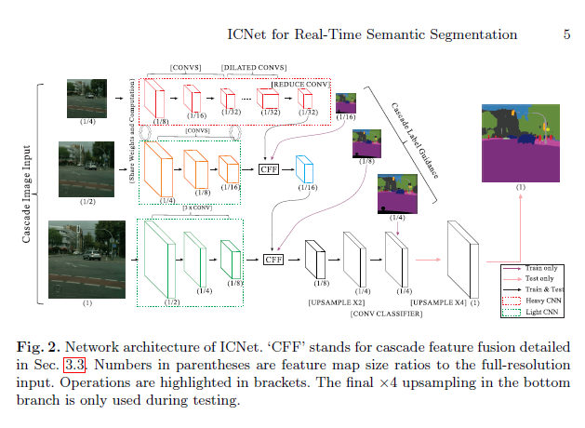
3. Image Cascade Network
Start form high performance segmentation framework PSPNet

Slide 11
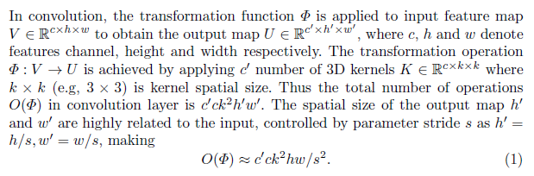
3.1 Speed Analysis
INPUT IMG SIZE (H,W)
KERNAL (C)

Slide 12
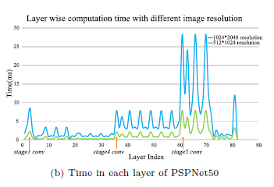
3.1 Speed Analysis
INPUT IMG SIZE : 1024*2048, 512*1024
KERNAL (C) : stage5 (1024*2048), stage4 (512*1024)

Slide 13
3.2 Network Architecture
Image cascade network (ICNet)
Cascade image inputs (i.e., low-, medium- and high resolution images)
Adopts cascade feature fusion unit
Trained with cascade label guidance

Slide 14
3.2 Network Architecture
To overcome this shortcoming (time consuming), we get semantic extraction using low-resolution input as shown in top branch of Fig. 2.
A 1/4 sized image is fed into PSPNet with downsampling rate 8 (Heavy CNN), resulting in a 1/32-resolution feature map.
--> Coarse prediction

Slide 15
3.2 Network Architecture
To get high quality segmentation, medium and high resolution branches help recover and refine the coarse prediction.
Thus we can safely limit the number of parameters in both middle and bottom branches.

Slide 16
3.3 Cascade Feature Fusion (CFF)
Two feature maps F1 and F2
🡪 F1 : C1 x H1 x W1, F2 : C2 x H2 x W2
🡪 F2 is with doubled spatial size of F1
Ground-truth label with resolution 1 x H2 x W2
We first apply upsampling rate 2 on F1 through bilinear interpolation, yielding the same spatial size as F2.
Then a dilated convolution layer with kernel size C3 x 3 x 3 and dilation 2 is applied to refine the upsampled features.
The resulting feature of F1 is with size C3 x H2 x W2
Notes:
Deconvolution대신에 dilated CNN을 쓰는 이유 : 내부에 zero paddin을 추가하여 강제로 receptive field를 늘린것이라 같은 receptive field에서 Deconvolution보다 연산효율이 좋음

Slide 17
3.3 Cascade Feature Fusion (CFF)
For feature F2, a projection convolution with kernel size C3 x 1 x 1 is utilized to project F2 so that it has the same number of channels as the output of F1
Then two batch normalization layers are used to normalize these two processed
Followed by an element-wise `sum' layer and a `ReLU‘ layer, we obtain the fused feature F’2 as C3 x H2 x W2
To enhance learning of F1, we use an auxiliary label guidance on the upsampled feature of F1.

Slide 18
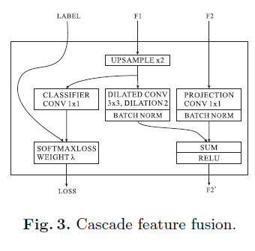
3.3 Cascade Feature Fusion (CFF)

Slide 19
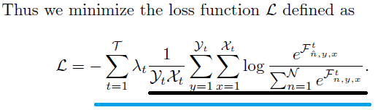
3.4 Cascade Label Guidance
To enhance the learning procedure in each branch, we adopt a cascade label guidance strategy.
It utilizes different-scale (e.g., 1/16, 1/8, and 1/4) ground-truth labels

Slide 20
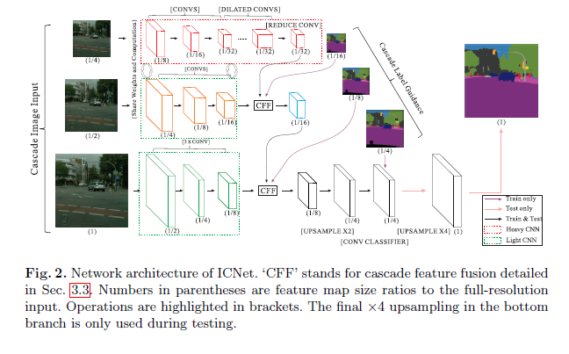
Network Architecture

Slide 21
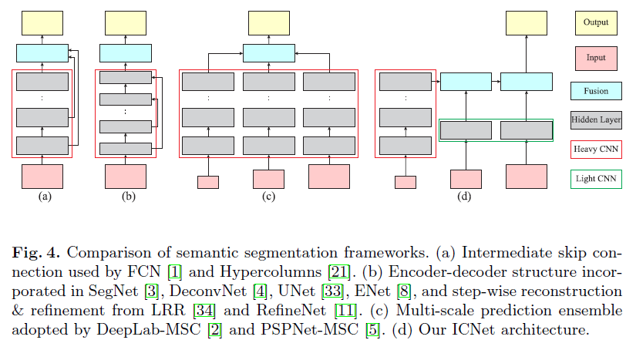
4. Structure Comparison and Analysis

Slide 22
5. Experimental Evaluation
Cityscapes with image resolution 1024 x 2048
CamVid with image resolution 720 x 960
COCO-Stuff with image resolution up to 640 x 640

Slide 23
5.1 Implementation Details.
The mini-batch size is set to 16
The base learning rate is 0.01 and the `poly' learning rate policy is adopted with power 0.9
The maximum iteration number set to 30K for Cityscapes, 10K for CamVid and 30K for COCO-Stuff
Momentum is 0.9 and weight decay is 0.0001
Data augmentation contains random mirror and rand resizing between 0.5 and 2
The auxiliary loss weights are empirically set to 0.4 for λ1 and λ2, 1 for λ3 in Eq. 2
For evaluation, both mean of class-wise intersection over union (mIoU) and network forward time (Time)

Slide 24
5.2 Cityscapes
High-resolution 1024 x 2048 images
It contains 5,000 finely annotated images split into training, validation and testing sets with 2,975, 500, and 1,525 images respectively.
The dense annotation contains 30 common classes of road, person, car, etc.
19 of them are used in training and testing.

Slide 25
5.2 Cityscapes
Intuitive Speedup According to the time complexity shown in Eq. (1), we do intuitive speedup in three aspects
namely downsampling input, downsampling feature, and model compression.

Slide 26
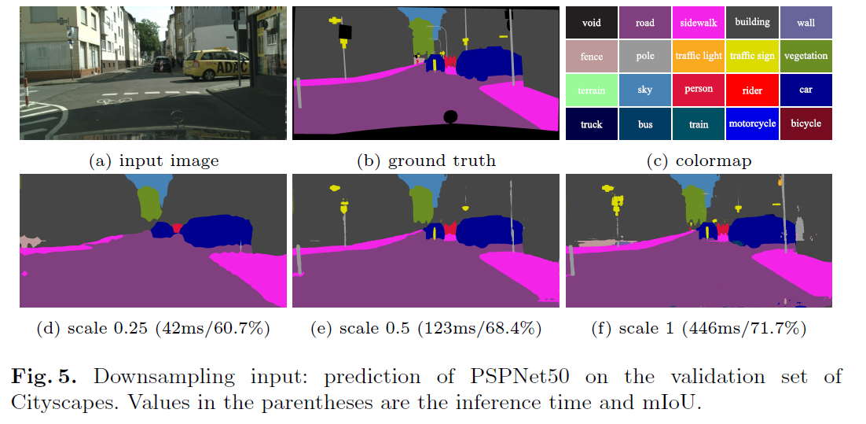
5.2 Cityscapes
Downsampling input

Slide 27
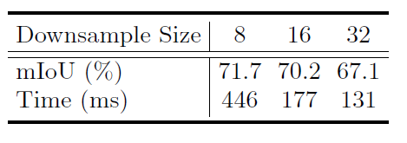
5.2 Cityscapes
Downsampling Feature
Scale down the feature map by a large ratio in the inference process
downsampling ratios of 1:8, 1:16 and 1:32

Slide 28
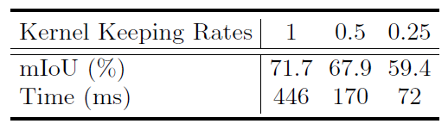
5.2 Cityscapes
Model compression
Reduce network complexity is to trim kernels in each layer
For each filter, we first calculate the sum of kernel L1-norm. Then we sort these sum results in a descending order and keep only the most significant ones.

Slide 29
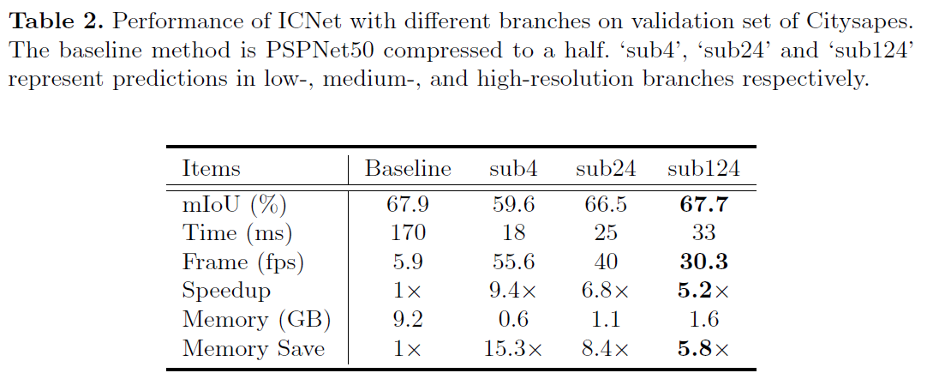
5.2 Cityscapes
Cascade Branches

Slide 30
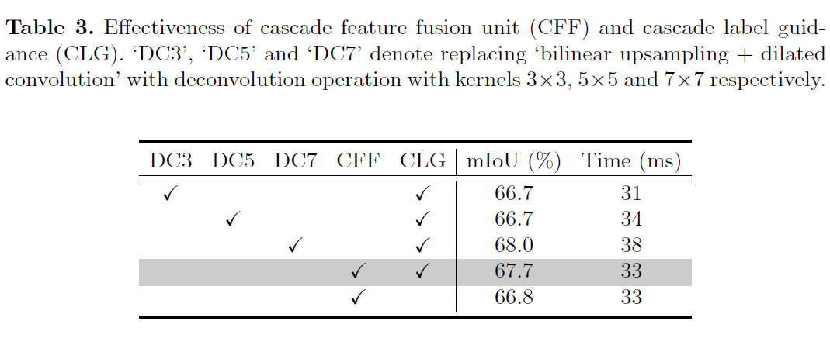
5.2 Cityscapes
Cascade Structure

Slide 31
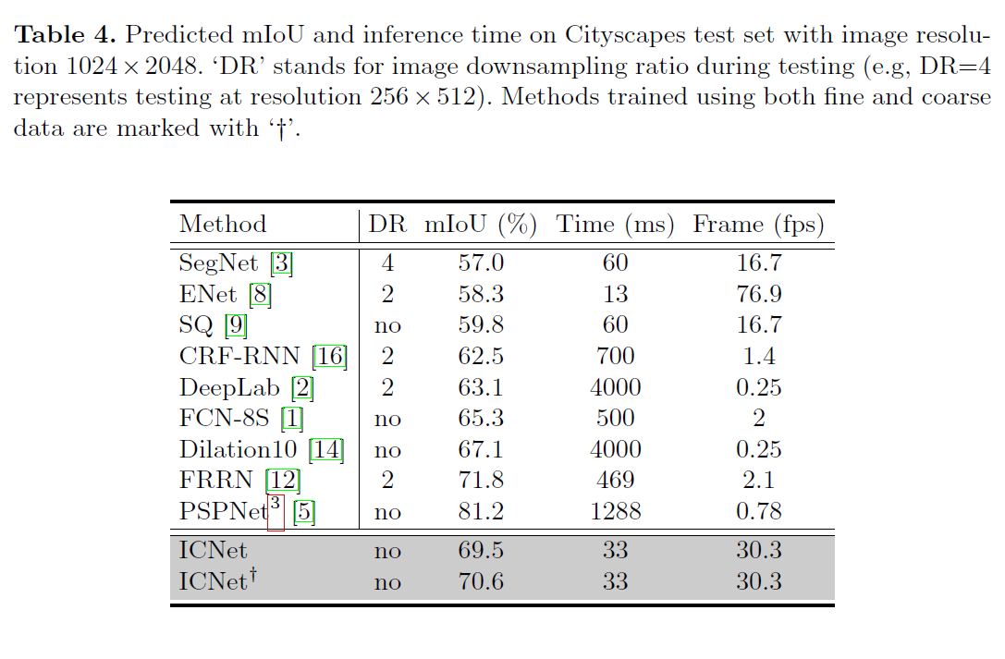
5.2 Cityscapes
Methods Comparison

Slide 32
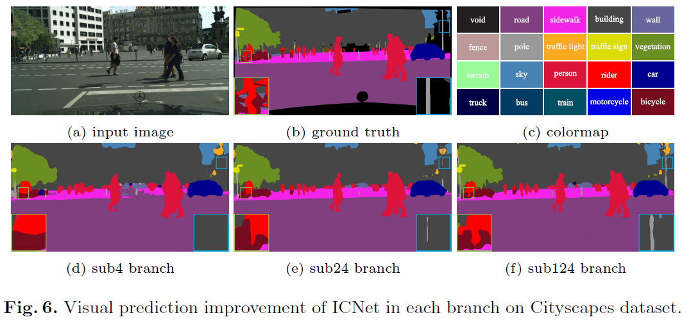
5.2 Cityscapes
Visual Improvement

Slide 33
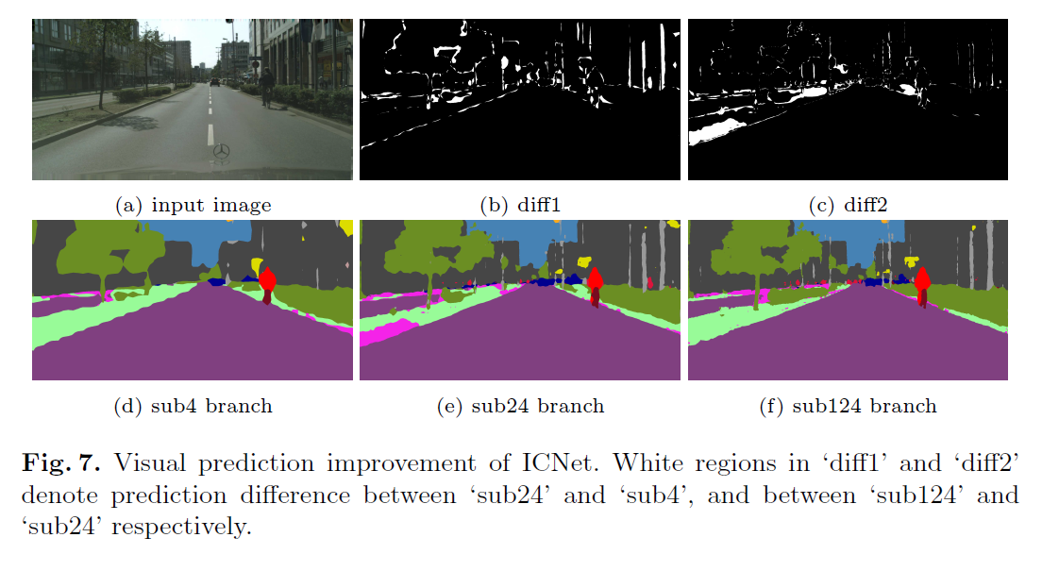
5.2 Cityscapes
Visual Improvement

Slide 34
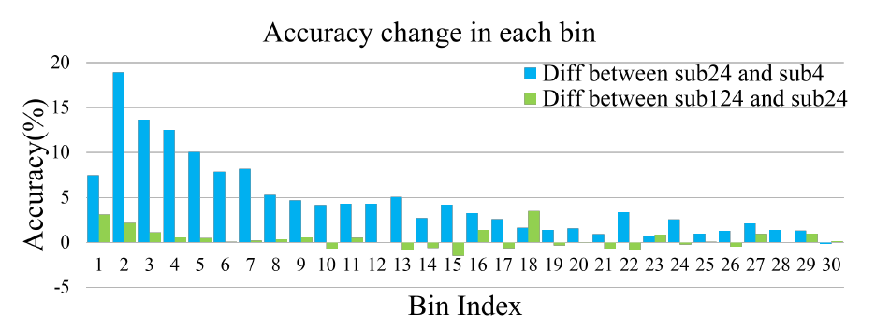
5.2 Cityscapes
Quantitative Analysis

Slide 35
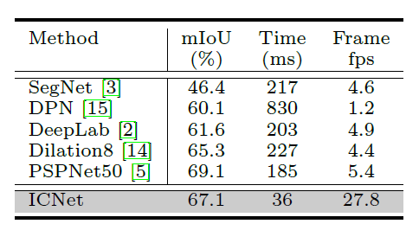
5.3 CamVid
Resolution up to 720 x 960
Dataset into 367, 100, and 233 images for training, validation and testing respectively.
11 semantic classes are used for evaluation.

Slide 36
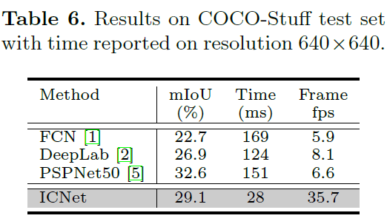
5.3 COCO-Stuff
Resolution up to 640 x 640
up to 182 classes are used for evaluation, including 91 thing and 91 stuff classes.

Slide 37
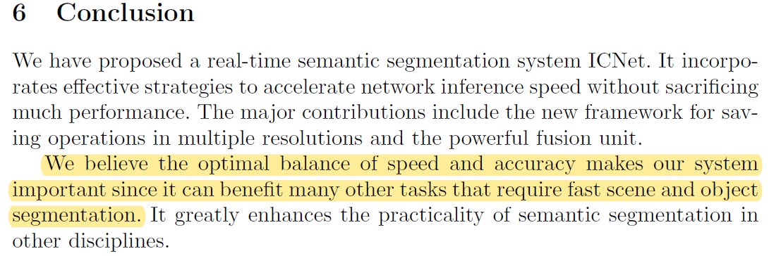
6. Conclusion

Slide 38
Thank you for your attention
Notes:
-이것으로 저널 발표를 마치겠습니다. 감사합니다

